Slide 1

PREDICTING NFL Play calls for optimum success
Williams Anosike
DATA 06
This Photo by Unknown Author is licensed under CC BY-SA

Slide 2
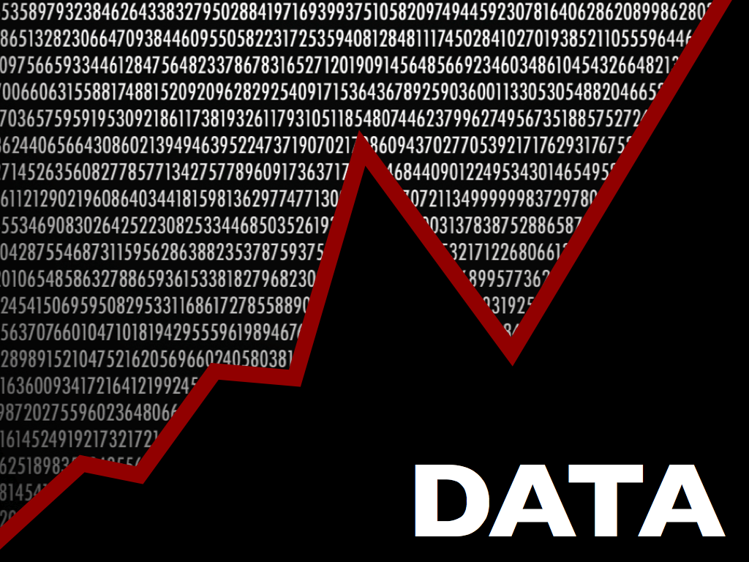
Dataset
The dataset contains all the regular season plays from the 2009-2018 NFL seasons. The dataset has 449,372 rows and 100 columns. Each play is broken down into great detail containing information on: game situation, players involved, results, and advanced metrics such as expected point and win probability values.
Compiled using an R package, nflscrapR which uses an API maintained by the NFL to scrape, clean, parse, and output clean datasets at the individual play, player, game, and season levels.
This Photo by Unknown Author is licensed under CC BY-NC-ND
This Photo by Unknown Author is licensed under CC BY-SA

Slide 3
OUTLINE
In this PowerPoint, I’ll talk about the first steps taken in building a viable model for our dataset.
First, I will talk about the data cleaning and filtering I completed.
Then, I’ll discuss the Exploratory Data Analyses I have done to get a better sense of the data and what insights we can take away.

Slide 4
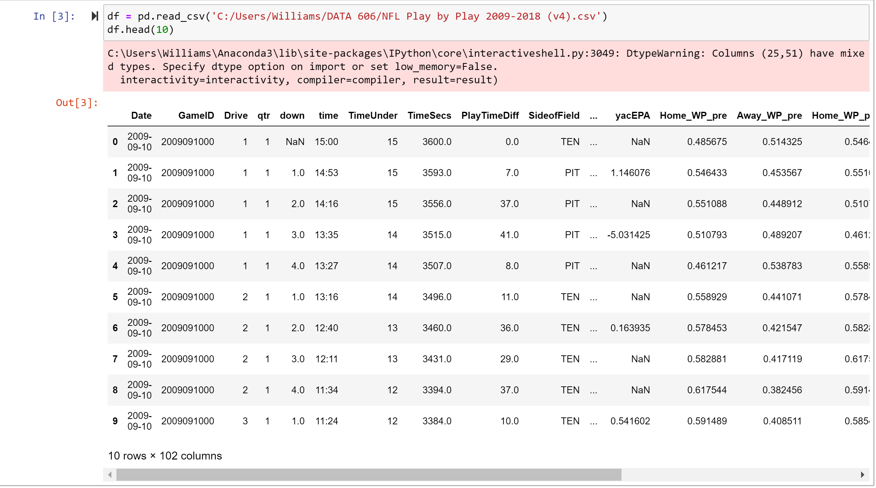
DATA EXTRACTION/LOADING
By far the easiest part of the project so far; I simply downloaded the zipped dataset from Kaggle.
I then unzipped and extracted the content into my DATA606 folder.

Slide 5
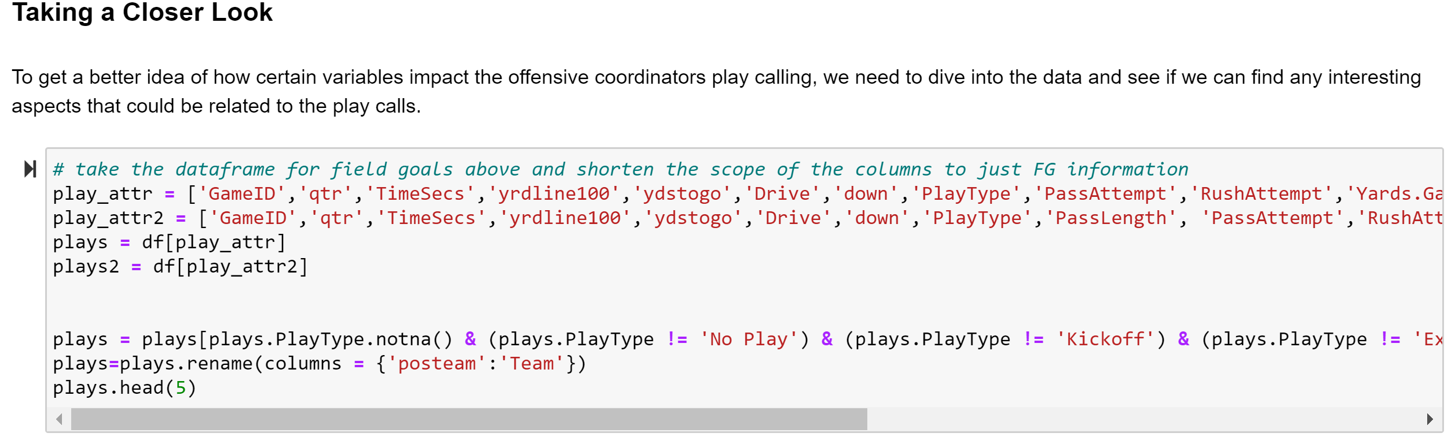
DATA CLEANING & FILTERING
Here I removed columns I deemed unnecessary and filtered on the columns I needed for my model.
I also filled out NA values to make my model even more accurate.

Slide 6
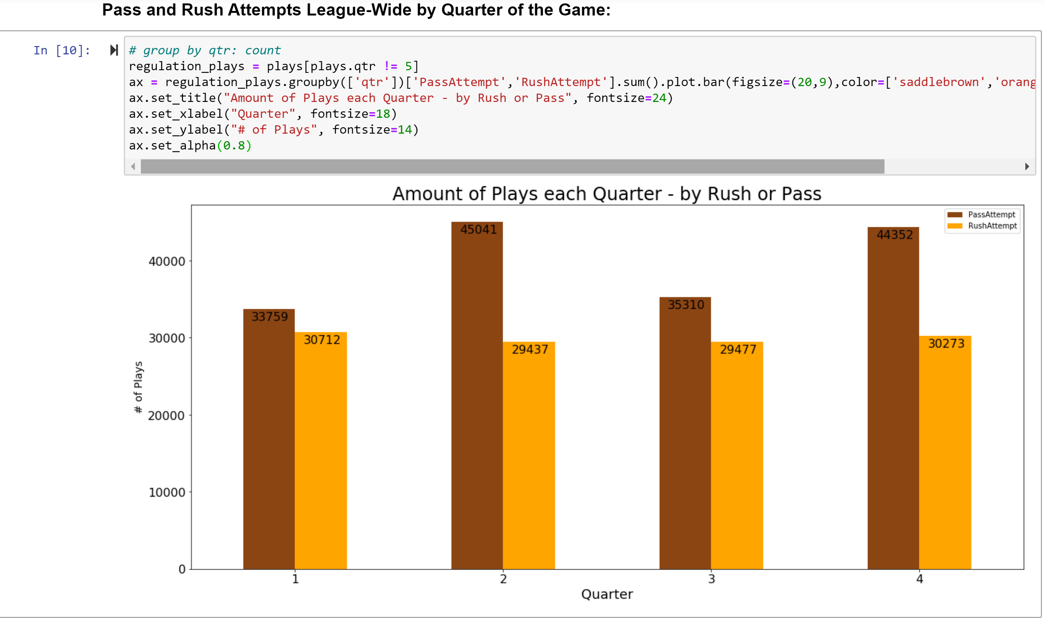
EXPLORATORY DATA ANALYSIS (EDA)
Wanted to see a league-wide view of the pass vs rush attempts.
As we can see, it seems that passing plays are more prominent in all categories.
One important distinction here is that the 2nd and 4th quarters see a spike in the amount of passing attempts, but the rushing attempts remains constant across the quarters.
This is most likely due to teams trying to score before the possession changes in the 2nd half or to win at the end of the game due to the expiring clock.

Slide 7
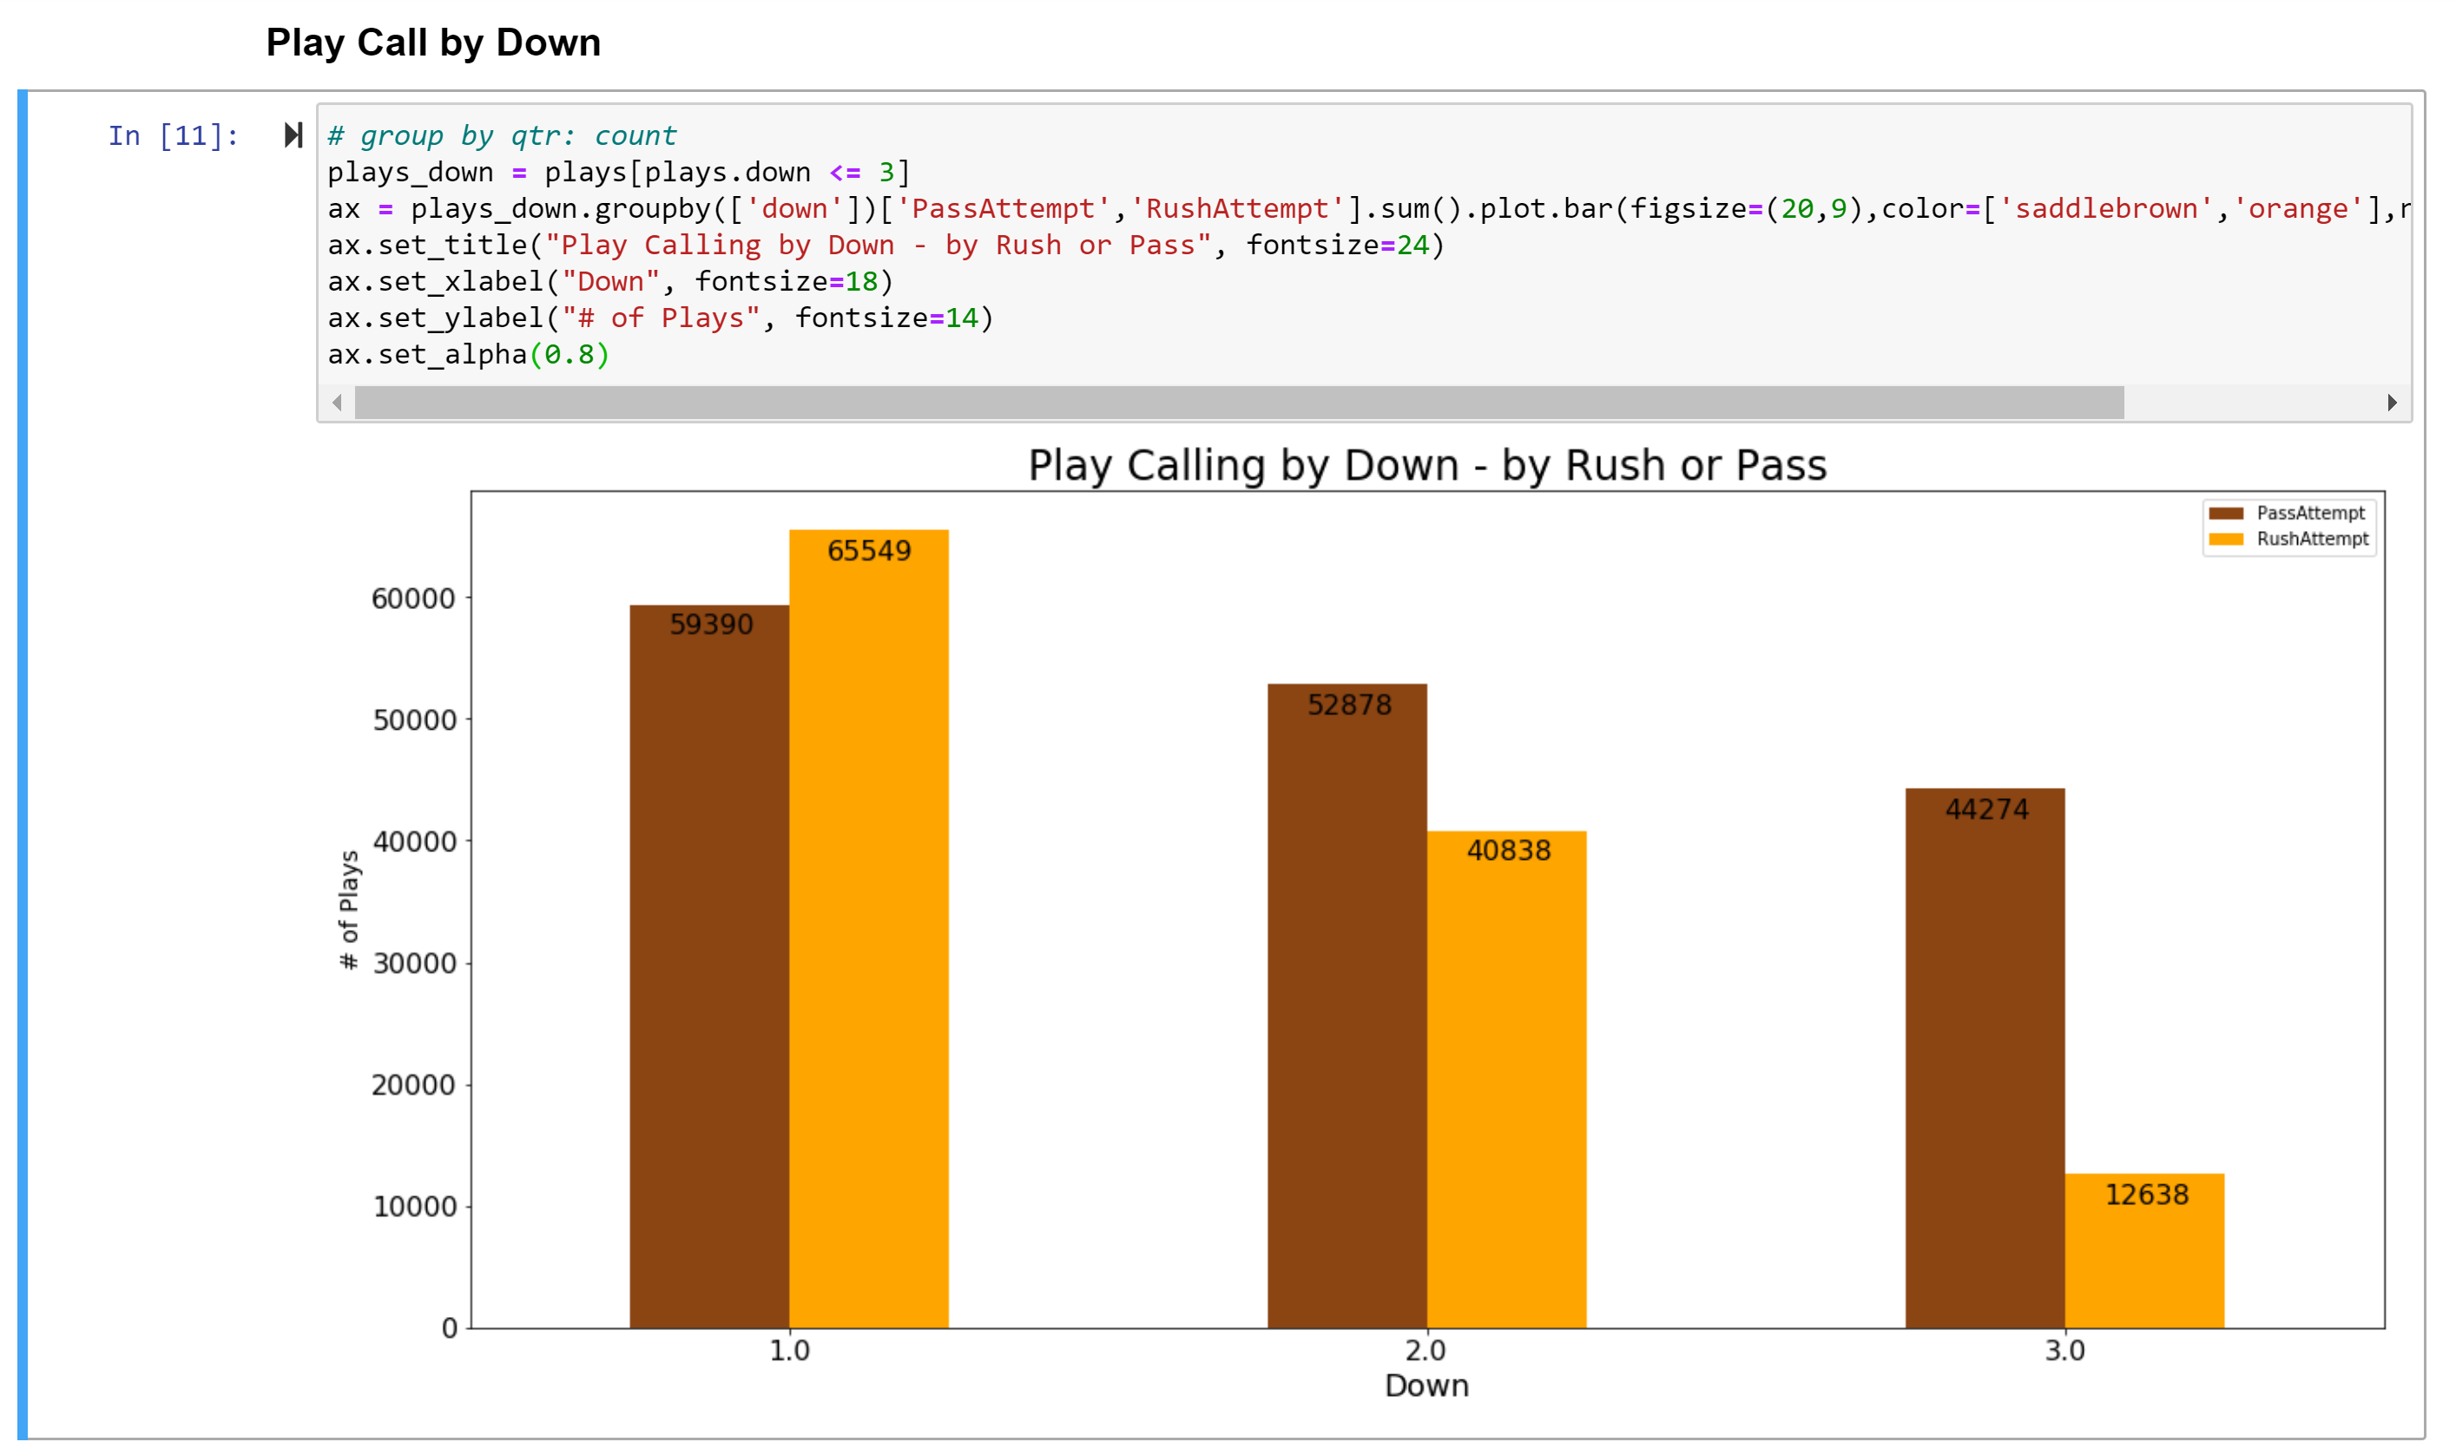
EXPLORATORY DATA ANALYSIS (EDA)
Then, I analyzed pass vs rush attempts per down around the NFL.
Here we see results we may expect. On 1st down, many teams often start out their drives with runs to open up their playbook.
On 3rd down, where the average yards to go was 4.6 yards from 2009-2018; it is realistic to see teams passing it more often in this situation.

Slide 8
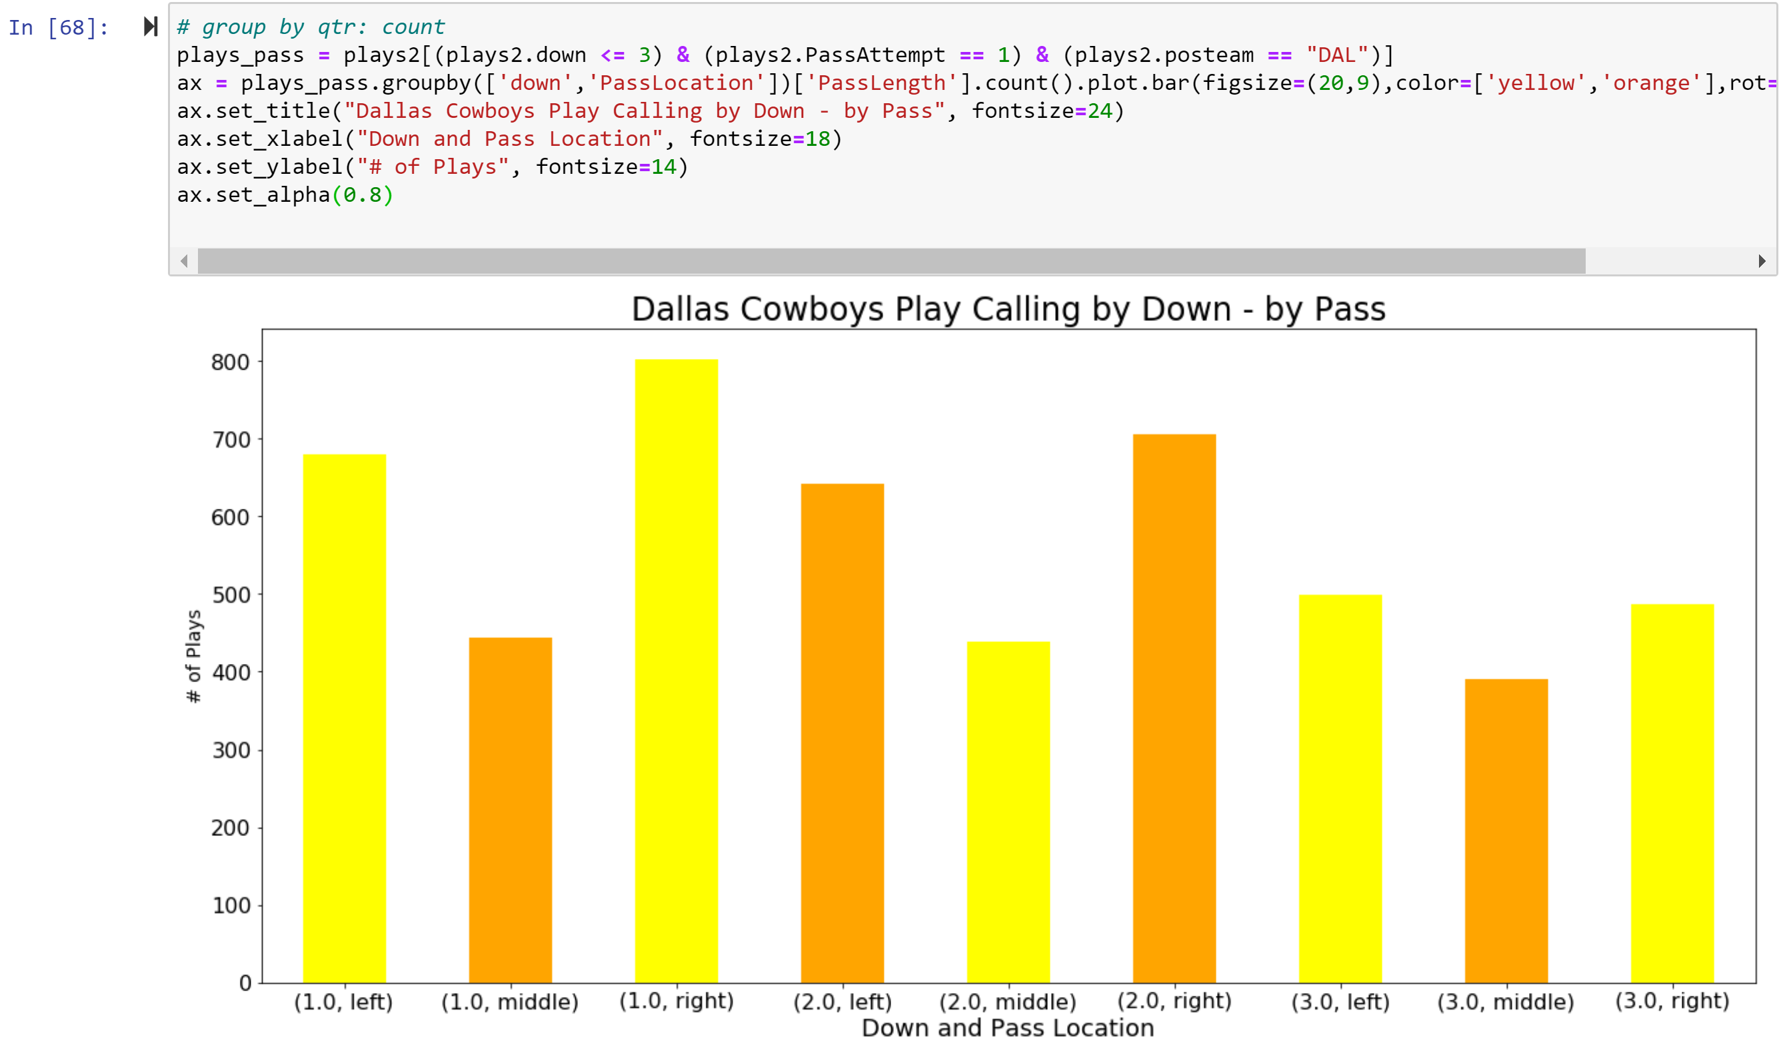
EXPLORATORY DATA ANALYSIS (EDA)
Next, I specifically analyzed the passing vs rushing attempts for specific teams. (Did this for the Cowboys, Eagles & Giants)
I then looked closer into the passing attempts and grouped them by their location and down.

